Slide 1
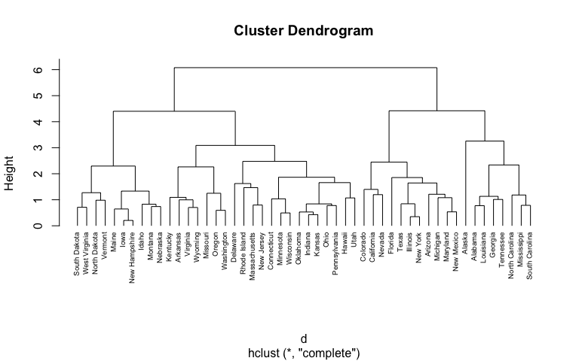
Hierarchical Clustering
Group A presentation
Adnan Amin

Slide 2

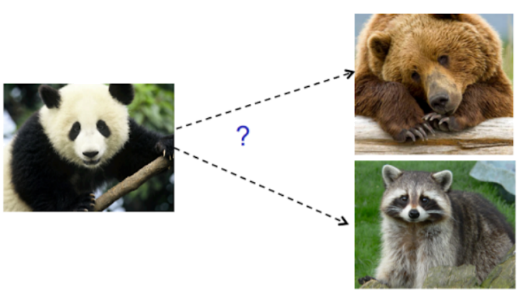
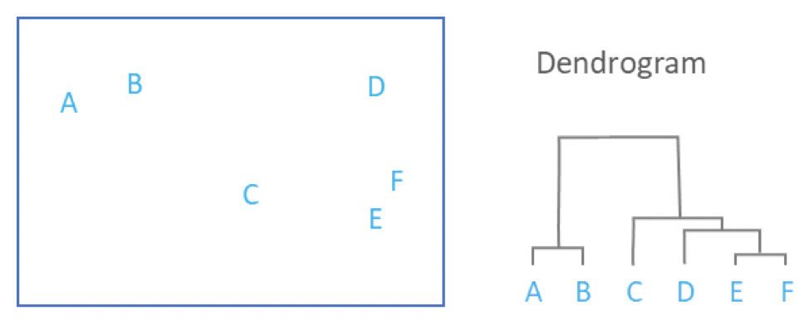
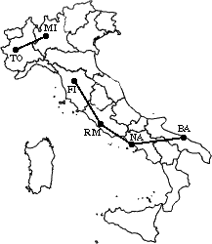
Outlines
What is Hierarchical Clustering?
Types of Hierarchical Clustering
Applications
Algorithms for Hierarchical Clustering
Single Linkage Algorithm
Dry-Run Example
Implementation in Python

Slide 3
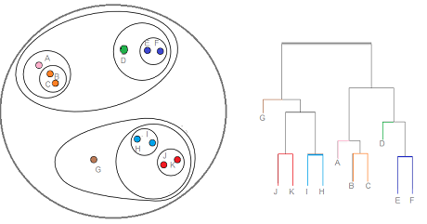
What is Hierarchical Clustering?
Hierarchical clustering, also known as hierarchical cluster analysis, is an algorithm that groups similar objects into groups called clusters.

Slide 4
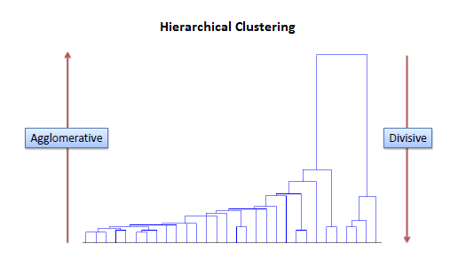
Types of Hierarchical Clustering
Divisive:
In divisive or top-down clustering method we assign all of the observations to a single cluster and then partition the cluster to two least similar clusters. Finally, we proceed recursively on each cluster until there is one cluster for each observation.
Agglomerative:
In agglomerative or bottom-up clustering method we assign each observation to its own cluster. Then, compute the similarity (e.g., distance) between each of the clusters and join the two most similar clusters. Finally, repeat steps 2 and 3 until there is only a single cluster left.

Slide 5
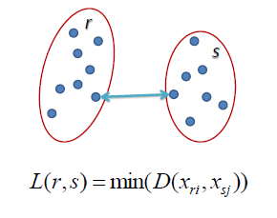
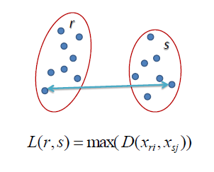
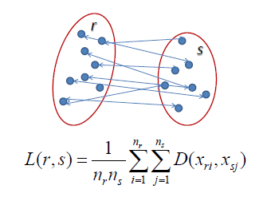
Methods to Measure Clusters
Single Linkage
In single linkage hierarchical clustering, the distance between two clusters is defined as the shortest distance between two points in each cluster. For example, the distance between clusters “r” and “s” to the left is equal to the length of the arrow between their two closest points.
Complete Linkage
In complete linkage hierarchical clustering, the distance between two clusters is defined as the longest distance between two points in each cluster. For example, the distance between clusters “r” and “s” to the left is equal to the length of the arrow between their two furthest points.
Average Linkage
In average linkage hierarchical clustering, the distance between two clusters is defined as the average distance between each point in one cluster to every point in the other cluster. For example, the distance between clusters “r” and “s” to the left is equal to the average length each arrow between connecting the points of one cluster to the other.

Slide 6
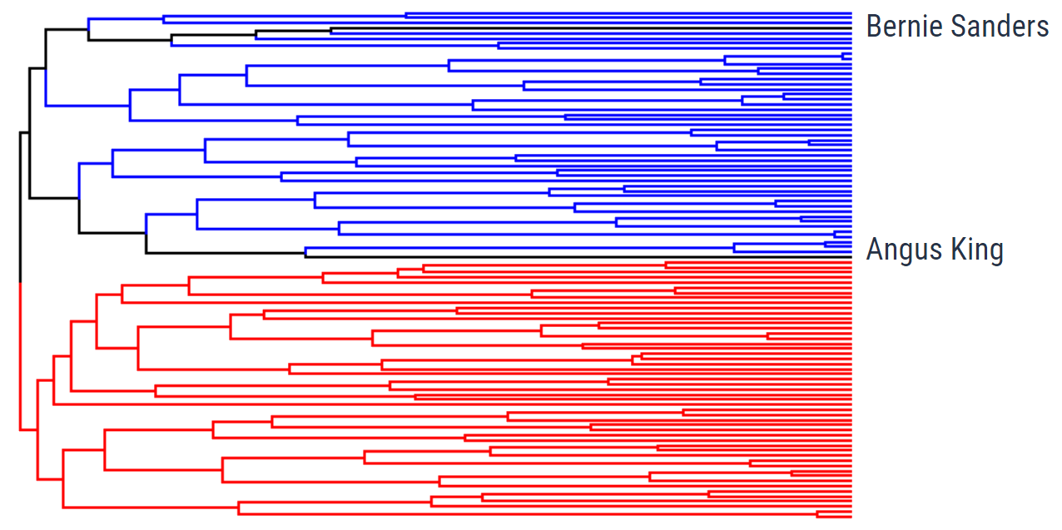
Applications
1) US Senator Clustering through Twitter
Can we find the party lines through Twitter?

Slide 7
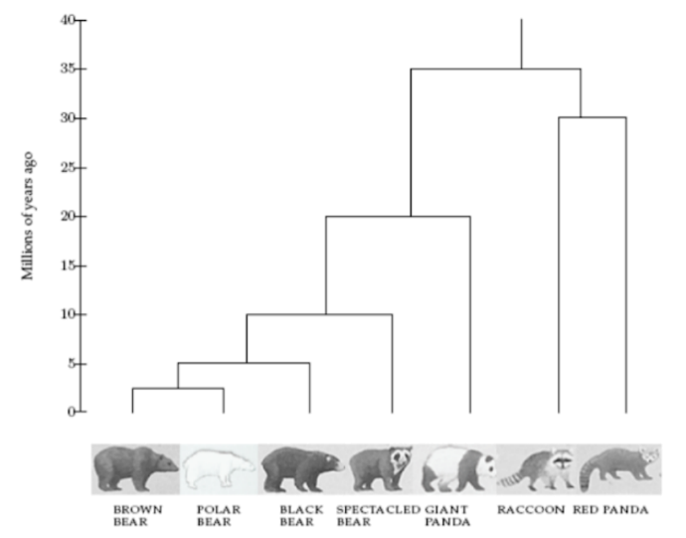
Applications
2) Charting Evolution through Phylogenetic Trees
How can we relate different species together?

Slide 8
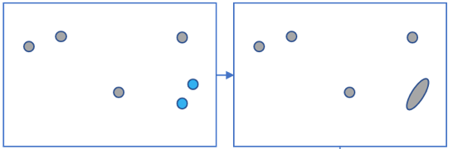
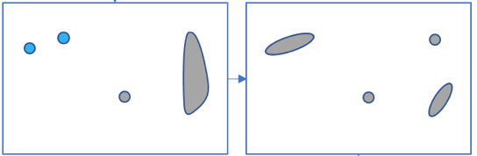

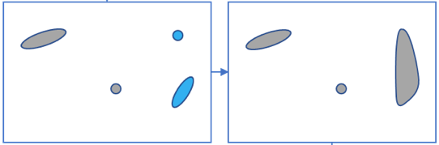
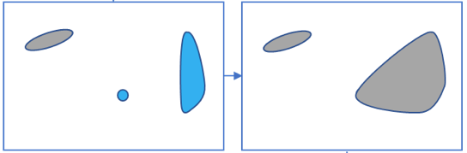
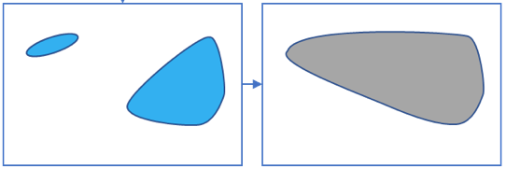
How hierarchical clustering works (Agglomerative Clustering):

Slide 9
How hierarchical clustering works (Agglomerative Clustering) cont..:
The main output of Hierarchical Clustering is a dendrogram, which shows the hierarchical relationship between the clusters:

Slide 10
Single Linkage Clustering: The Algorithm
The N*N proximity matrix is D = [d(i,j)]. The clusterings are assigned sequence numbers 0,1,......, (n-1) and L(k) is the level of the kth clustering. A cluster with sequence number m is denoted (m) and the proximity between clusters (r) and (s) is denoted d [(r),(s)].
The algorithm is composed of the following steps:
Begin with the disjoint clustering having level L(0) = 0 and sequence number m = 0. Find the least dissimilar pair of clusters in the current clustering, say pair (r), (s), according to d[(r),(s)] = min d[(i),(j)] where the minimum is over all pairs of clusters in the current clustering. Increment the sequence number : m = m +1. Merge clusters (r) and (s) into a single cluster to form the next clustering m. Set the level of this clustering to L(m) = d[(r),(s)] Update the proximity matrix, D, by deleting the rows and columns corresponding to clusters (r) and (s) and adding a row and column corresponding to the newly formed cluster. The proximity between the new cluster, denoted (r,s) and old cluster (k) is defined in this way: d[(k), (r,s)] = min d[(k),(r)], d[(k),(s)] If all objects are in one cluster, stop. Else, go to step 2.

Slide 11
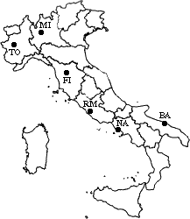
Dry-Run Example
Let’s now see a simple example: a hierarchical clustering of distances in kilometers between some Italian cities. The method used is single-linkage.
Input distance matrix (L = 0 for all the clusters):
 | BA | FI | MI | NA | RM | TO
BA | 0 | 662 | 877 | 255 | 412 | 996
FI | 662 | 0 | 295 | 468 | 268 | 400
MI | 877 | 295 | 0 | 754 | 564 | 138
NA | 255 | 468 | 754 | 0 | 219 | 869
RM | 412 | 268 | 564 | 219 | 0 | 669
TO | 996 | 400 | 138 | 869 | 669 | 0

Slide 12
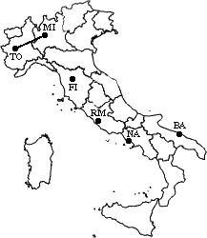
Dry-Run Example
 | BA | FI | MI/TO | NA | RM
BA | 0 | 662 | 877 | 255 | 412
FI | 662 | 0 | 295 | 468 | 268
MI/TO | 877 | 295 | 0 | 754 | 564
NA | 255 | 468 | 754 | 0 | 219
RM | 412 | 268 | 564 | 219 | 0

Slide 13
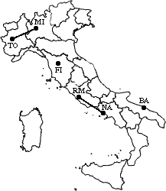
Dry-Run Example
 | BA | FI | MI/TO | NA/RM
BA | 0 | 662 | 877 | 255
FI | 662 | 0 | 295 | 268
MI/TO | 877 | 295 | 0 | 564
NA/RM | 255 | 268 | 564 | 0

Slide 14
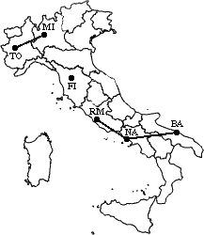
Dry-Run Example
 | BA/NA/RM | FI | MI/TO
BA/NA/RM | 0 | 268 | 564
FI | 268 | 0 | 295
MI/TO | 564 | 295 | 0

Slide 15
Dry-Run Example
 | BA/FI/NA/RM | MI/TO
BA/FI/NA/RM | 0 | 295
MI/TO | 295 | 0

Slide 16
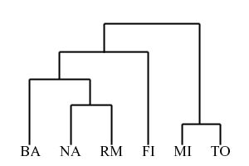
Dry-Run Example
The process is summarized by the following hierarchical tree:

Slide 17
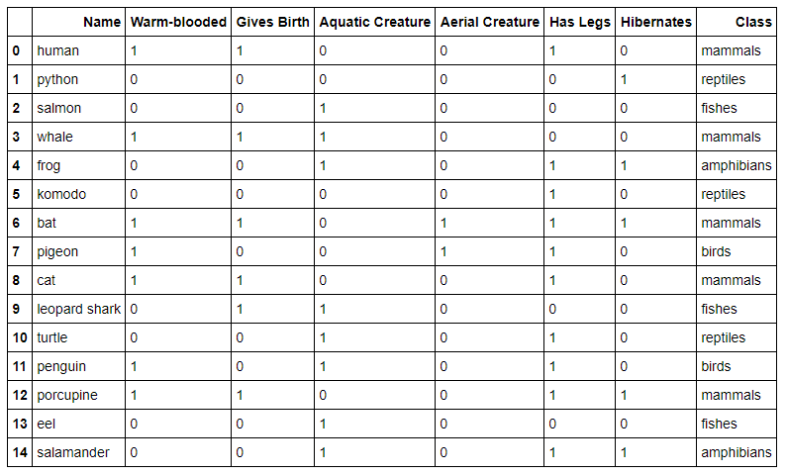
Problem and Implementation in Python
This section demonstrates examples of applying hierarchical clustering to the vertebrate dataset.

Slide 18
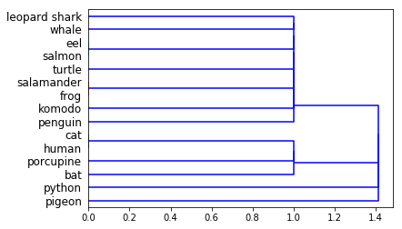
Problem and Implementation in Python cont..
import pandas as pd
data = pd.read_csv('vertebrate.csv',header='infer')
data
from scipy.cluster import hierarchy
import matplotlib.pyplot as plt
%matplotlib inline
names = data['Name’]
Y = data['Class’]
X = data.drop(['Name','Class'],axis=1)
Z = hierarchy.linkage(X.as_matrix(), 'single’)
dn = hierarchy.dendrogram(Z,labels=names.tolist(),orientation='right')
This section demonstrates examples of applying hierarchical clustering to the vertebrate dataset.

Slide 19

Q & A

Slide 20
Thanks

